Slide 1
Uninformed Search
Artificial Intelligence
September 9, 2019

Slide 2
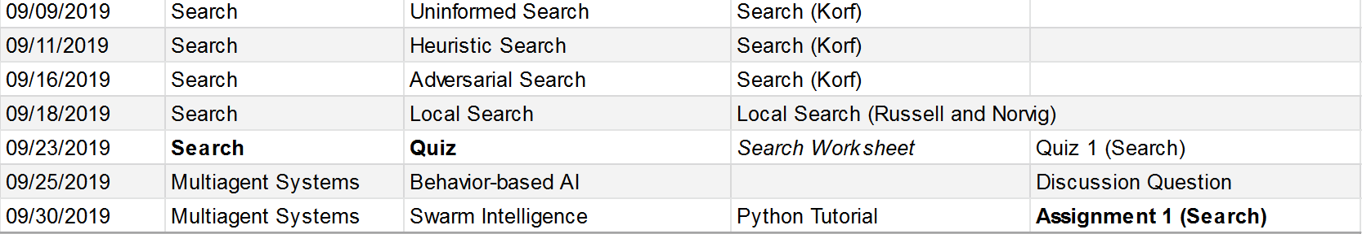
Plan

Slide 3

Topic 2: Search
Uninformed search
Heuristic search
Adversarial search
Local search

Slide 4

This reading is at a higher conceptual level, so consult slides and online resources

Slide 5
Agenda
Introduction to search & problem space model
Basic brute force search strategies
In-class activity
Analysis of search algorithms
Improving brute-force search algorithms

Slide 6
Introduction to Search & Problem Space Model

Slide 7
Single agent path finding: Eight Puzzle Problem

Slide 8
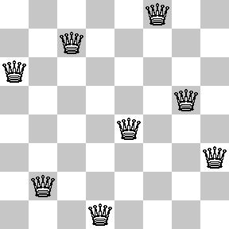
Constraint satisfaction problem - Eight-Queens Problem

Slide 9
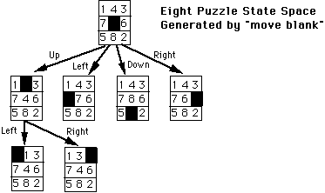
Eight-Puzzle Problem Space (State Space)

Slide 10
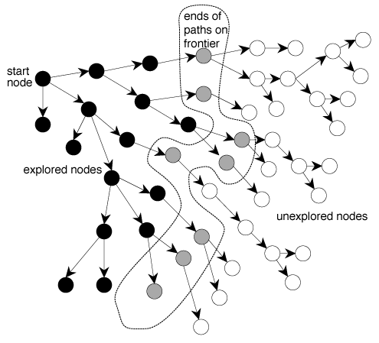
General Problem Space

Slide 11
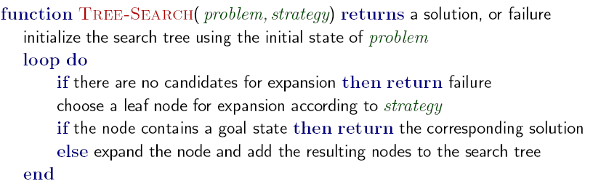
Basic AI Search Algorithm

Slide 12
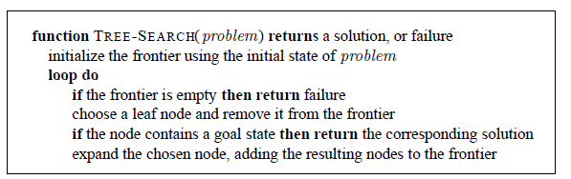
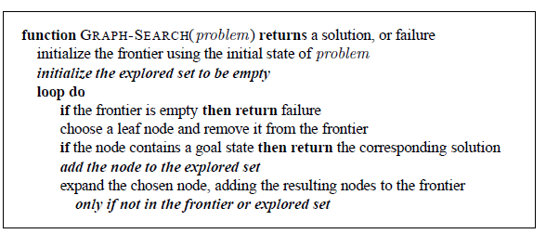
Tree search vs. graph search (differences in italics)

Slide 13
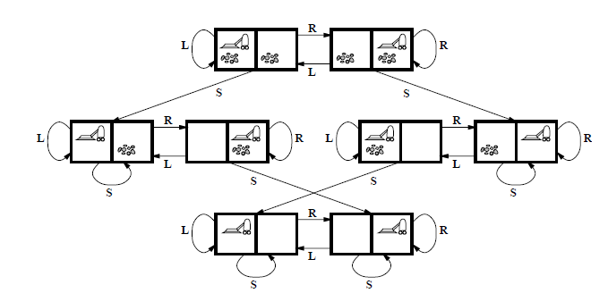
Robotic Vacuum Cleaner as a search problem

Slide 14
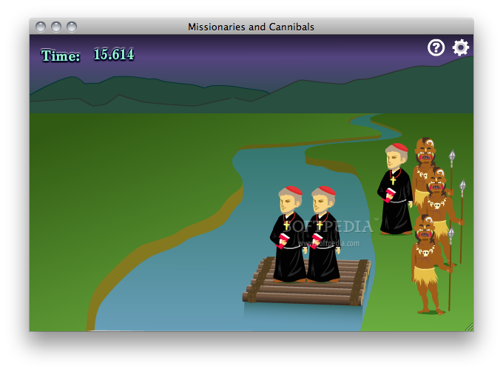
Three missionaries and three cannibals must cross a river using a boat which can carry at most two people, under the constraint that, for both banks, if there are missionaries present on the bank, they cannot be outnumbered by cannibals (if they were, the cannibals would eat the missionaries). The boat cannot cross the river by itself with no people on board

Slide 15
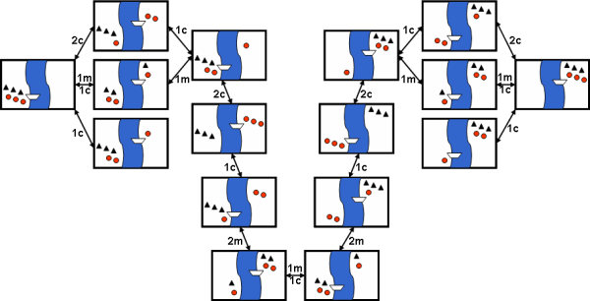
Search Tree for M & C

Slide 16
The Basic Brute force Search Strategies Breadth-first [BFS] and Depth-first [DFS]

Slide 17
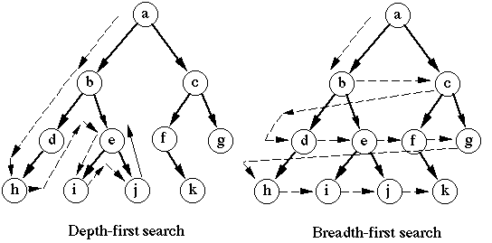
Depth first vs. Breadth first search

Slide 18
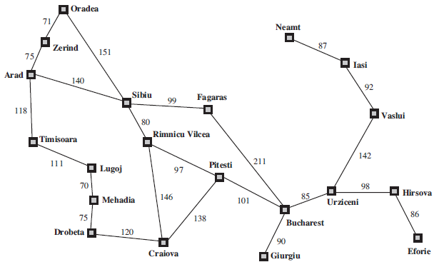
Path finding example (Arad to Bucharest)

Slide 19
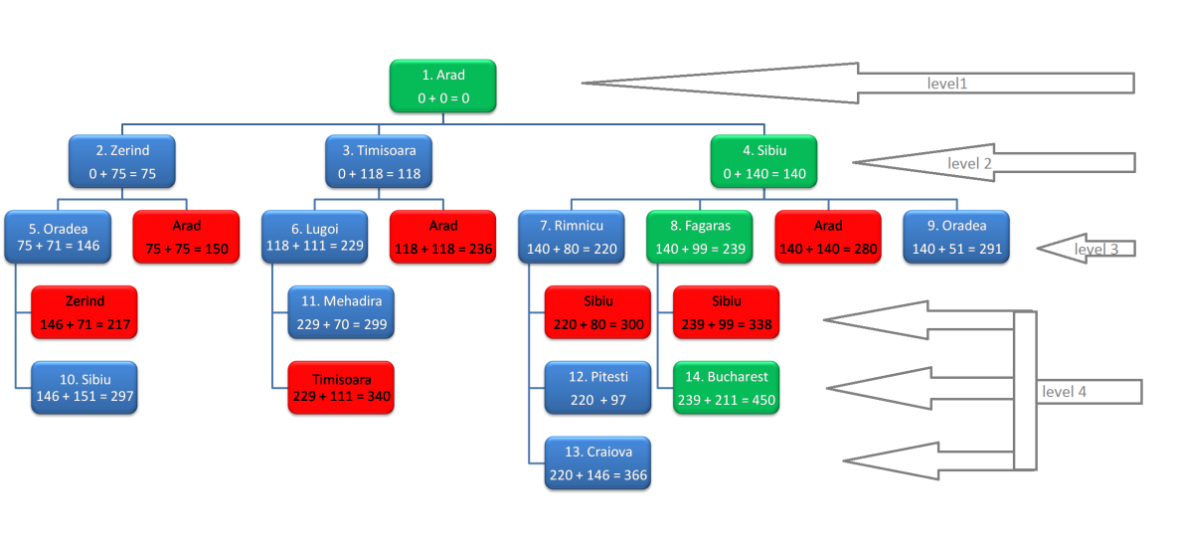
Breadth-first search from Arad to Bucharest (ignore path costs gives us Arad – Sibiu – Fagaras - Bucharest)

Slide 20
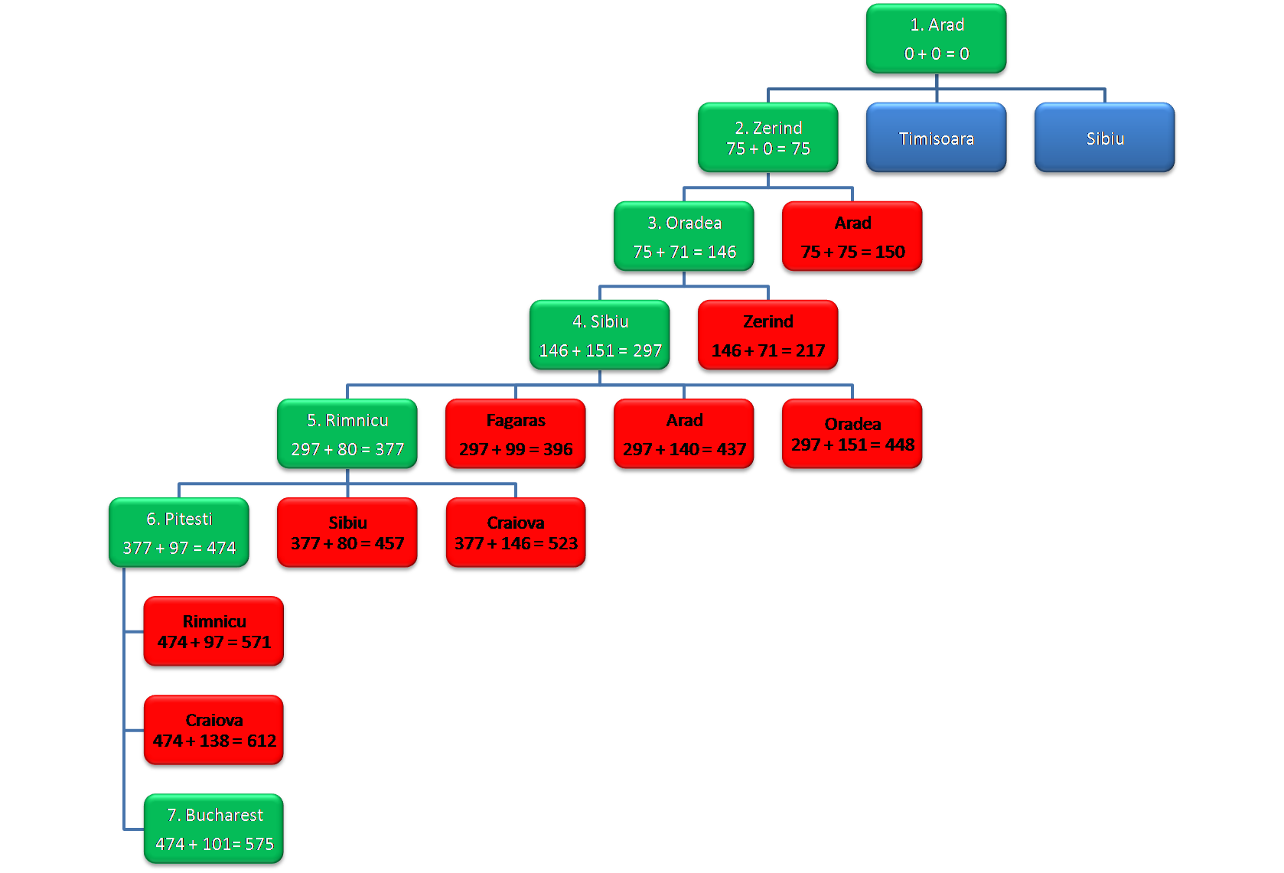
Depth-first search from Arad to Bucharest (ignore path costs for now)

Slide 21
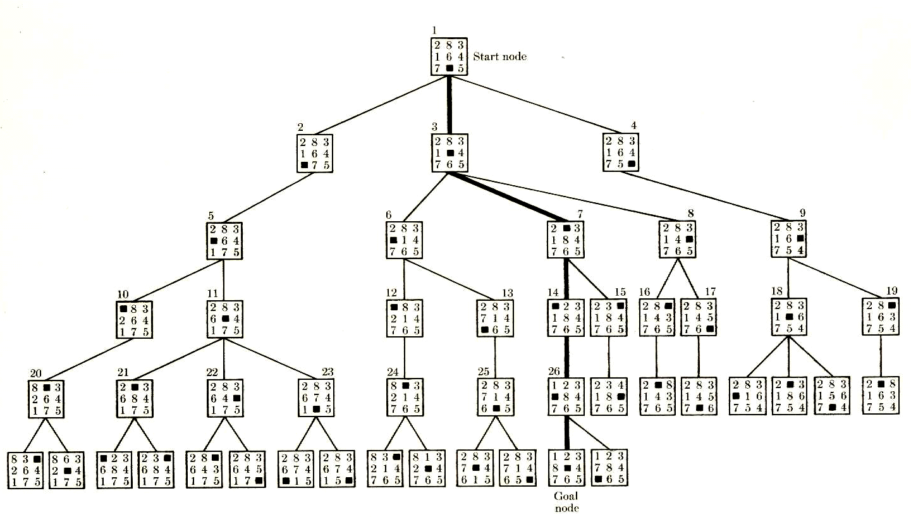
Breadth-first search on eight puzzle

Slide 22
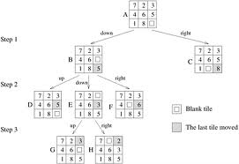
Depth-first search on eight-puzzle

Slide 23
In Class Activity

Slide 24
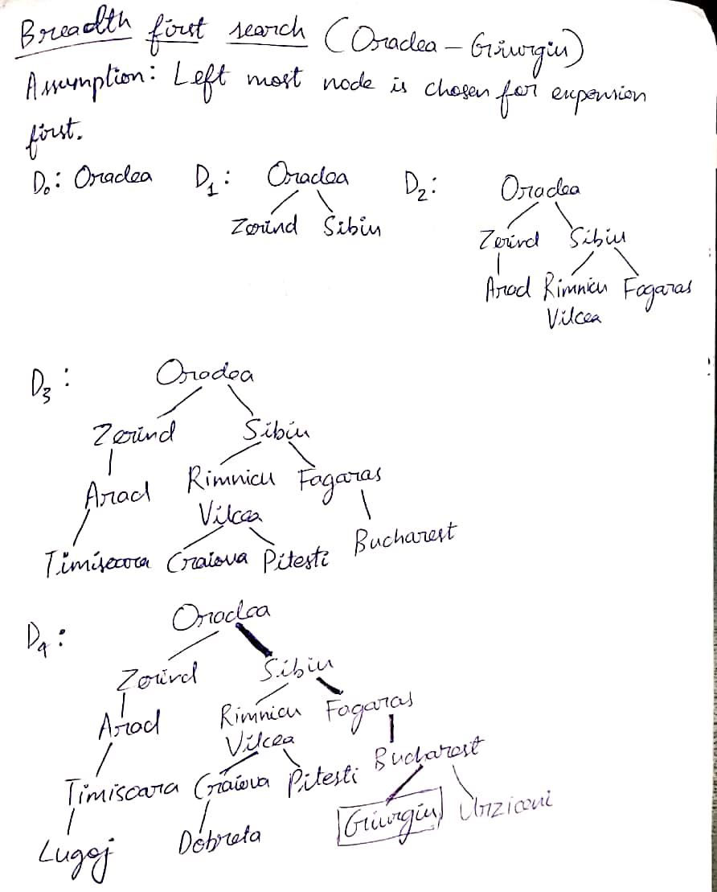
Notes:
Solution for In Class Activity BFS

Slide 25
Notes:
Solution for In Class Activity DFS

Slide 26
Evaluating Search Strategies

Slide 27
Depth first vs. Breadth first search

Slide 28
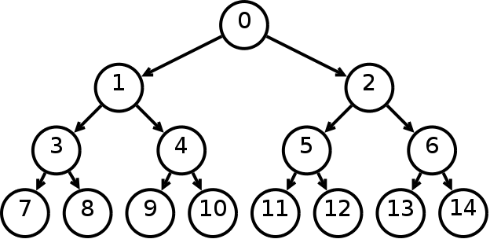
How many nodes in tree with branching factor(b) = 2?
d = 0; 1 node (2⁰)
d = 1; 2 nodes (2¹)
d = 2; 4 nodes (2²)
d = 3; 8 nodes (2³)
Total nodes – 2⁰ ⁺ 2¹ + 2² +…. 2^{d} = 2^{d} where d = solution depth
If b = branching factor, then b^{d} (the full tree)

Slide 29
Improved Search Strategies

Slide 30
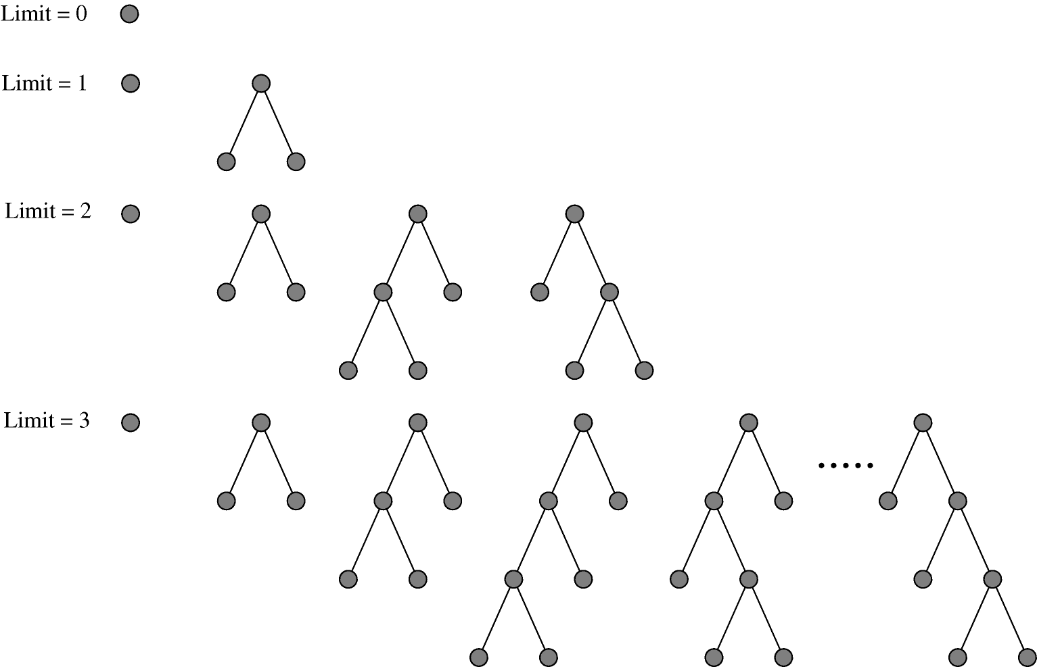
Depth Limited Search

Slide 31
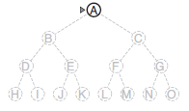
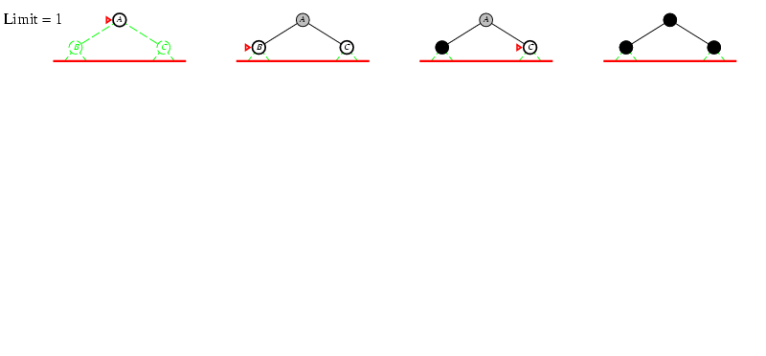
Iterative deepening search l =1

Slide 32
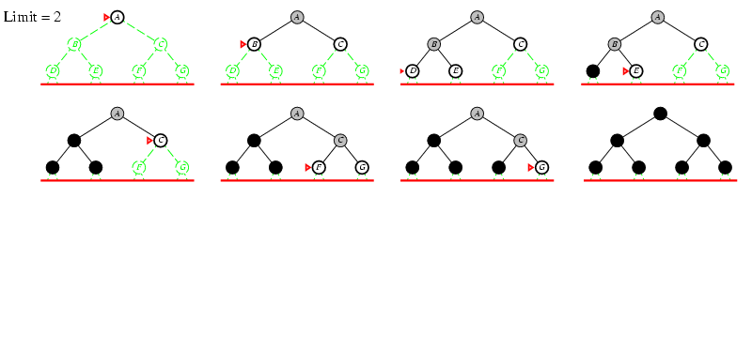
Iterative deepening search l =2

Slide 33
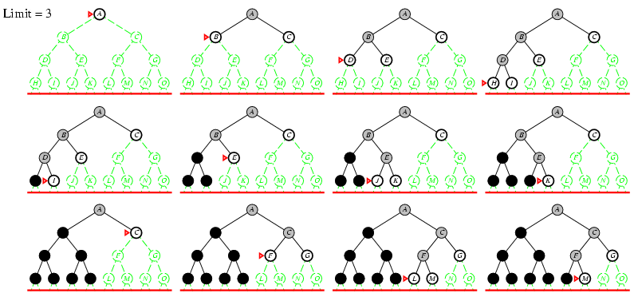
Iterative deepening search l =3

Slide 34
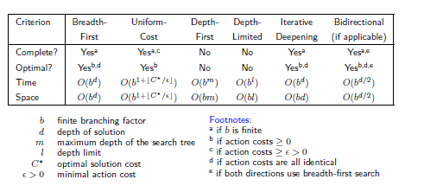
Comparing Search Strategies

Slide 35
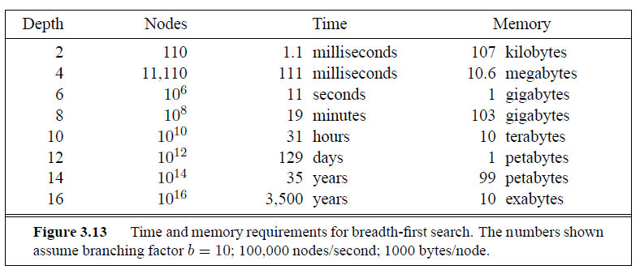
Time and Memory Requirements for BFS

Slide 36
Animations
https://qiao.github.io/PathFinding.js/visual/

Slide 37
Review

